Slide 1



The National Rural Employment Guarantee Act (NREGA)
PPT
PRESENTATION

Slide 2


Introduction
My name is Yashashri. In this project, I have utilized visualizations using Power BI to analyze and present key insights related to the National Rural Employment Guarantee Act (NREGA).
This project involves comprehensive data cleaning and addresses several specific problems through visualizations to facilitate better understanding and decision-making.

Slide 3

Problem Statement
NREGA is a vital initiative to alleviate rural unemployment and poverty. This project seeks to address
several key questions and challenges associated with NREGA
1) How effective is NREGA in providing employment opportunities to rural households?
2) Are there regional disparities in the implementation and outcomes of the scheme?
3) What is the utilization of the allocated budget, and how does it correlate with
employment generation?
4) What are the key factors contributing to the completion of NREGA works, and are there
any roadblocks to its success?
5) Can data-driven insights guide policymakers and administrators in optimizing the
scheme's impact?

Slide 4


Dataset Information
The dataset used for this analysis is sourced from official government records and contains information related to NREGA implementation across various states and districts in India. It comprises 28 columns, encompassing data on job cards, worker details, budget allocation, work completion statistics, expenditure, and more. This dataset offers a comprehensive view of the progress and challenges faced by the NREGA program.

Slide 5
Data Cleaning
Some columns contain monetary values with too many decimal points. I have rounded these values to 2 decimal points in the dataset.
I have managed null values and removed duplicate rows to ensure data accuracy and integrity.
I have verified and corrected the data types for all columns to ensure consistency and accuracy.
I have renamed some columns to make the dataset more readable and understandable.
After performing these steps, the dataset is now clean and ready for analysis.

Slide 6
Project Description
Key Performance Indicators (KPIs) are created using household employment days, total workers, and total expenditure in lakhs.
Slicers are implemented using state and district names to facilitate easy data filtering.
An area chart is used to display the total households worked by average employment days.
A stacked bar chart is used to show the top 5 states by average employment per household.
A matrix is used to display the total approved budget and total workers by state names.
A clustered bar chart shows the total number of completed works versus the total number of works by district.
A line chart shows the total expenditure and the total number of works by the percentage of category B works.
A funnel chart displays district names by active job cards.
A clustered column chart shows total completed works and total outgoing works by state.

Slide 7
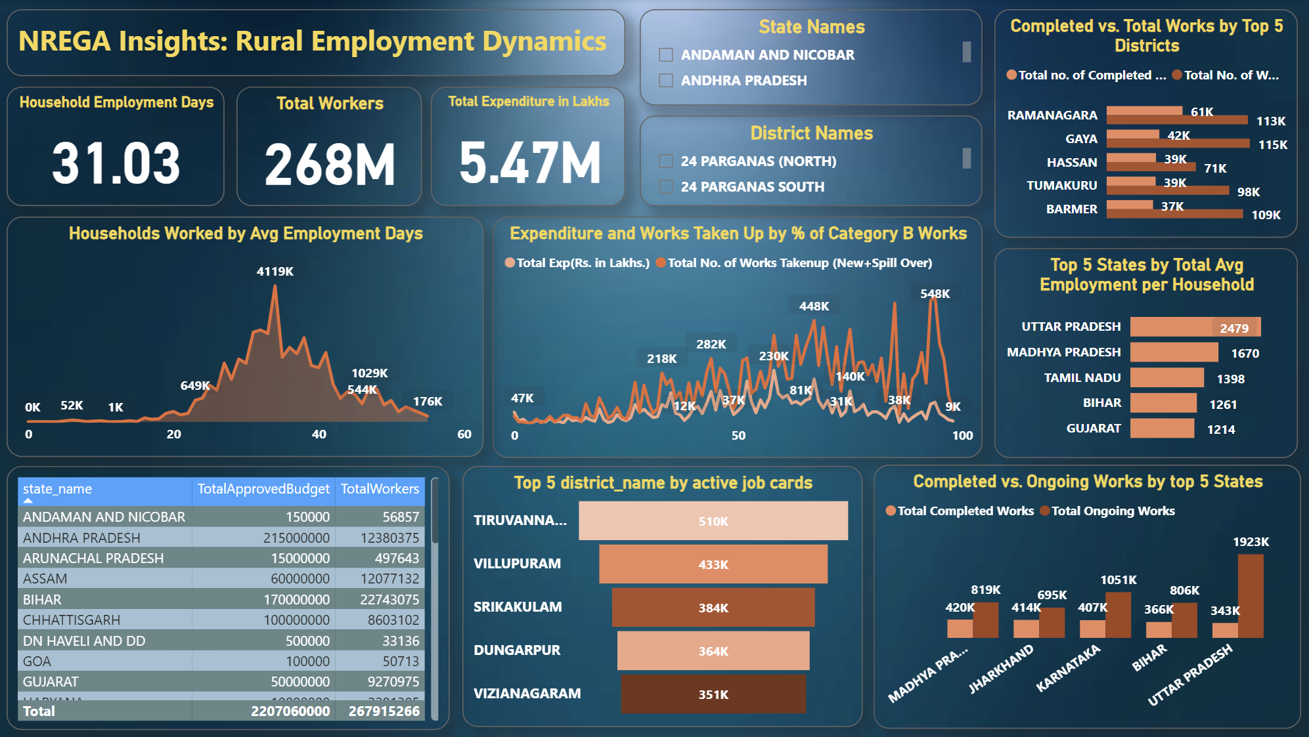

Slide 8
Thank You
I have completed the third task of mentorness

